Slide 1
Friday, September 2, 2016
Write In Your Agenda:
Write In Your Monitoring Log:
CW:
Quiz
Planet Earth video and note sheet.
HW:
Have Monitoring Log signed
Response to Warm-Up:
Write a question you have about the quiz or a statement about how prepared you are.
You will need:
Pencil

Slide 2
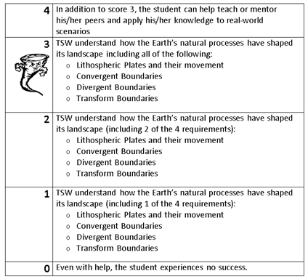
Learning Goal and Scale
TSW understand how the Earth’s natural processes have shaped its landscape (including Lithospheric Plates and their movement, Convergent, Divergent, and Transform boundary landforms).

